Slide 1

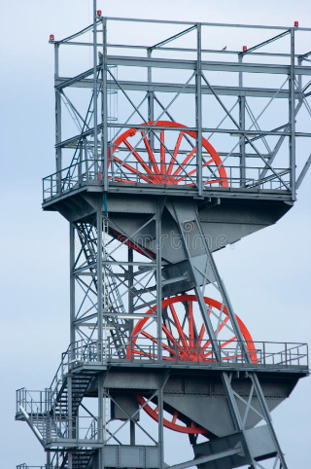
SHAFTS & WINDERS_HEAL
Highlights: SolRock Weekend No. 16 Completed Nch2 Dewatering Project: JoJo Tanks Installation: EMB Preparing to start Monday 08Dec2025
Lowlights: Positions to be filled taking considerable time to complete: 1 x Rigger Ropesman: @ Recommendation Stage: Motivation required for Over-compliment 1 x WTFitter: @ Offer Routing for Approval Stage: 1 x WTFitter: @ Offer Routing for Approval Stage: Nch3 PW Horn Actuator Faulty after 20 + years_Removed for refurbishment and will be replaced once completed
Emerging Issues: Low compliment of Fitters and Riggers in Mechanical Section is still putting pressure on the Section Massive impact of providing full Maintenance of Changehouses of all 3 x Shafts….
Priorities: Shaft Repair Work with Solrock Team_Weekend No.17 Employee Engagement/Resignations Engagement with SGM: Busy with IDP’s sessions with Team Assist with 3rd Quarter Safety Campaign Shaft Exam with Machinery Inspector Shaft Dewatering – Pump Test DMPR Instruction on Shafts & WInders
You Can Help By: Please provide an update on: Adjustments (Package) for Shaft & Winder Personnel to ensure Scares Skills are retained…. Please provide an update on: Assist with Winder Permit Rectifications + Winder Exemptions to DMPR…. Discuss and Motivate Memo for Shafts & Winders Services Supervisor Position with EM Thank You for the Permission to: 12 Dec 2025: to have a Year – End Braai at work similar to the Friday Braai currently in place

Slide 2
SHAFTS & WINDERS_HEAL
Highlights: Annual Shaft Schedule on Par (Next 2 x Slides)
JAN
 | EMT's/MRT's
 | DECEL TESTS
FEB
 | NCH2_PW_BE
 | NCH3_PW_BE
 | NCH2_SHAFT_GUIDE REPL
 | NCH2_3-7LVL_CHUTE LINERS
MARCH
 | NCH2_SHAFT_GUIDE REPL
 | NCH2_PW_FE
 | NCH3_PW_FE
 | NCH2_RW_FE
 | NCH2_PW_DYNAMICS
 | NCH3_PW_DYNAMICS
 | GL_PW_DYNAMICS
 | NCH2_RW_DYNAMICS
APRIL
 | EMT's/MRT's
 | DECEL TESTS
 | NCH2_REMOVE OLD CABLES
 | NCH2_3-7LVL_LDB LINERS
 | NCH2_PW_ANNUAL MHE
 | NCH3_PW_ANNUAL MHE
 | GL_PW_ANNUAL MHE
 | NCH2_RW_ANNUAL MHE
 | NCH2_PW_ANNUAL EHE
 | NCH3_PW_ANNUAL EHE
 | GL_PW_ANNUAL EHE
 | NCH2_RW_ANNUAL EHE

Slide 3
SHAFTS & WINDERS_HEAL
Highlights: Annual Shaft Schedule on Par (Next Slide)
MAY
 | NCH2_SHAFT_GUIDE REPL
JUNE
 | NCH2_PW_STATICS
 | NCH3_PW_STATICS
 | GL_PW_STATICS
 | NCH2_RW_STATICS
 | NCH2_3-7LVL_LDB LINERS
JULY
 | NCH2_3-7LVL_LDB LINERS
 | DECEL TESTS
AUG
 | NCH2_3-7LVL_LDB LINERS

Slide 4
SHAFTS & WINDERS_HEAL
Highlights: Annual Shaft Schedule on Par (Next Slide)_Depicting upcoming work for Nov2025 & Dec2025
SEP
 | NCH2_PW_DYNAMICS
 | NCH3_PW_DYNAMICS
 | GL_PW_DYNAMICS
 | NCH2_RW_DYNAMICS
OCT
 | NCH3_PW_FE
 | NCH2_PW_FE
 | GL_PW_FE
 | NCH2_RW_FE
 | NCH2_3-7LVL_LDB LINERS
 | NCH3_PW_MRT
 | NCH2_PW_MRT
 | GL_PW_MRT
 | NCH2_RW_MRT
NOV
 | NCH2_REPL_BUNTON 13
 | NCH2_3-7LVL_LDB LINERS
 | NCH3_PW_LVL 1 AUDIT
 | NCH2_PW_LVL 1 AUDIT
 | GL_PW_LVL 1 AUDIT
 | NCH2_RW_LVL 1 AUDIT
DEC
 | NCH3_PW_LVL 1 AUDIT
 | NCH2_PW_LVL 1 AUDIT
 | GL_PW_LVL 1 AUDIT
 | NCH2_RW_LVL 1 AUDIT

